Slide 1
The Disability Tax Credit (DTC)
A Practical Guide for People with Disabilities and their Families
By Disability Alliance BC

Slide 2
Presentation Objectives
This presentation will address the following questions
What is the disability tax credit?
What are the potential benefits?
Who is eligible?
Primary Goal
Give a general understanding of the disability tax credit which will allow you to make informed decisions about the credit for yourself or your loved ones.

Slide 3
What is the DTC?
Two ways to think about the DTC

Slide 4
Narrow Understanding of the DTC
Disability Tax Credit:
Non-refundable and sometimes transferrable tax credit available to individuals with disabilities who have been approved to claim the credit by the Canada Revenue Agency (CRA).
“Non-refundable”
The DTC can be used to offset taxes you owe, but will not result in receiving money back if there is a surplus unused portion of the credit, it will not be paid directly to the individual
“Transferrable”
Unused portions of the DTC can be transferred to a spouse or certain family members in some circumstances

Slide 5
Broader Understanding of the DTC
The Disability Tax Credit is the mechanism by which the CRA determines eligibility for a broad range of supports available to persons with disabilities, including:
Non-refundable tax credits
Registered Disability Savings Plan (RDSP) Grants and Bonds
Working Income Tax Benefit Disability Supplement
Child Disability Benefit
This latter definition better encapsulates the true potential of the DTC.
However, many of these additional benefits are not designed to benefit older people with disabilities.

Slide 6
Eligibility for the DTC

Slide 7
Eligibility for the DTC
Applicant must have a severe and prolonged disability
Expected to last at least 12 months
And they are:
Blind/significantly visually impaired; or
Receive Life Sustaining Therapy (at least 14 hrs/wk); or
Markedly restricted in one or more of the following
Speaking, hearing, walking, eliminating, feeding dressing, performing mental functions necessary for everyday life
If a marked restriction cannot be established an applicant may still qualify if they can demonstrate that they have multiple significant restrictions which amounts to a marked restriction overall
These eligibility criteria are subject to definitions outlined by the CRA.

Slide 8
Key Terms
“Severe and prolonged”:
Severe is not explicitly defined. Prolonged is defined as lasting or expected to last at least 12 continuous months.
“Daily Living Activities”:
Feeding, dressing, speaking, hearing, eliminating, walking, mental functioning
“Markedly restricted” (with respect to daily living activities):
Even with appropriate therapy, the individual is unable or takes an inordinate amount of time to perform the activity in question all or substantially all of the time.
“Significantly restricted” (with respect to daily living activities):
A significant restriction is one that falls short of a marked restriction. A significant restriction in one daily living activity is insufficient to satisfy the eligibility criteria. If an applicant cannot demonstrate a marked restriction in one area, the CRA must be satisfied that they have significant restrictions in multiple areas of daily living which amount to a marked restriction overall. If you are applying on the basis of multiple significant restrictions your doctor should complete the “Cumulative effects of significant restrictions” section.
“Blind”:
Visual acuity is 20/200 or less in both eyes or person has a reduced diameter of field of vision totaling 20 degrees or less.
“Life sustaining Therapy”:
Therapy required to support a vital function needed at least 3 times per week for an average of 14 hours a week.

Slide 9
How to Apply for the DTC

Slide 10
Disability Tax Credit Certificate (Form T2201)
Applicants must submit the completed form T2201 to the CRA. In BC, T2201 forms can be sent to the Surrey Tax Centre
The updated T2201 form consists of a one-page applicant’s section and a five-page doctor/medical practitioner’s section. In reality the doctor’s section is actually likely to be closer to two-pages.
Applicant’s section: Requires contact details and other basic information. No medical information is required.
Medical Professional section: Must confirm in which areas the applicant is impacted (vision, life sustaining therapy, other daily living activities), and complete a one page section indicating the effects and duration of the impairment.

Slide 11
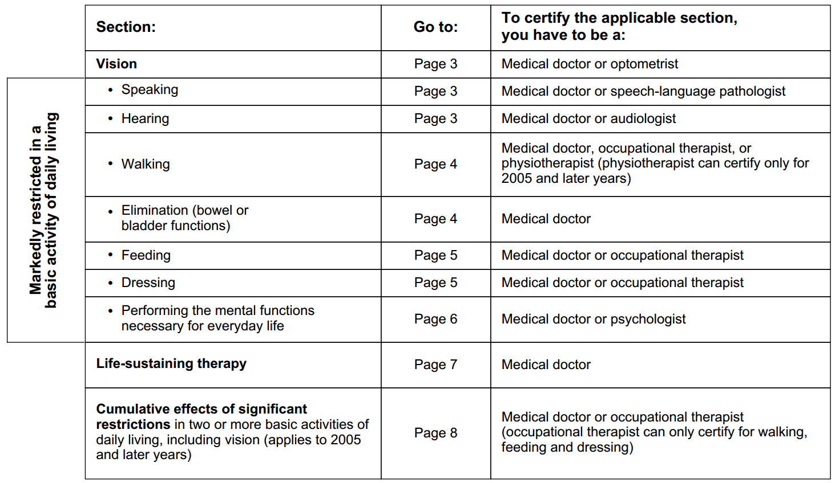
Medical Professional section
Note that the listed page numbers are taken from the previous version of the application.

Slide 12
Suggestions for completing the DTC Application (1/2)
Review the medical section of the application and determine which grounds apply to you.
Consider completing a sample/annotated version of the DTC application to bring with you when you take the form to your doctor or other medical practitioner (i.e. take a blank copy and a sample that you have provided)
This can save your doctor time and help ensure that s/he does not overlook aspects of your disability which may be relevant. However, remember that your doctor has the ultimate discretion to complete the application in accordance with their best medical judgment.

Slide 13
Suggestions for completing the DTC Application (2/2)
Pay special attention to the language you use in drafting the “Effects of Impairment” section. The focus should be on how you are specifically limited in one or more of the listed daily living activities. For example;
“Mrs Johnson has longstanding and ongoing difficulties with walking and dressing. She requires continuous use of a cane or walker as she has sustained previous injuries from falls in the recent past. As a result she walks 7-8 times slower than a healthy adult. Her osteoarthritis significantly impairs her ability to dress herself independently. Putting on socks and fastening buttons are particularly difficult for her due to the flexibility and fine motor coordination required. Without help, dressing takes her 4-5 times longer than it would for a healthy adult.”
Briefly review the sample version with the medical practitioner emphasizing the medical justifications for you to apply for the credit.

Slide 14
Submitting your Application
Residents of BC submit their DTC application to the Surrey Tax Centre.
9755 King George Boulevard
Surrey, BC
V3T-5E1
Processing times vary significantly.
Once an application has been reviewed, one of three things may happen:
Approval
Denial
Request for additional information
You can appeal a denial of the DTC.

Slide 15
Benefits of the DTC

Slide 16
The Disability Amount (Non-refundable Tax Credit)
The Disability Amount (for self) appears on line 316 of the General Income Tax and Benefit Return
For the 2015/16 tax year, the eligible amount for an adult with the DTC is $7,899.
Note, the actual amount of taxes this could offset will only be a percentage of this total. For most people, the actual amount of taxes that could be offset would be about $1184 (considering a base taxation rate of 15%)

Slide 17
T1 Adjustment
Individuals who have qualified for the DTC for prior years and want to claim the benefit of the DTC may need to request that their tax returns from those years be adjusted to account for their DTC eligibility.
Send a completed form T1-ADJ or a brief written letter outlining the details of the request to the Surrey Tax Centre.
Recent changes to the DTC application now allow applicants to request that their tax returns be automatically adjusted.

Slide 18
Eligibility to transfer the DTC
From a spouse or common-law partner
From another dependent
Relatively straightforward eligibility:
Together during the tax year
Approved to claim the DTC
Did not need the whole amount for self
More complex eligibility, consider claiming if
The person was dependent on you for basic necessities of life (food, shelter or clothing)
The dependent was you or your spouse’s parent, grandparent, child, grandchild, brother, sister, aunt, uncle, niece, or nephew
This is not a comprehensive list of eligibility criteria. Consult the Canada Revenue Agency or a tax professional to determine if you can transfer the DTC

Slide 19
How to claim the DTC on your tax return
This is not as straightforward a question as it seems.
Most tax returns are prepared electronically. There are several different programs available to prepare an electronic return.
The process of claiming or transferring the DTC, while usually not excessively difficult, will vary depending on what program is being used to prepare the tax return.
Most programs will have resources which explain how to claim or transfer the disability tax credit.

Slide 20
DTC Years of Approval
Do not claim the DTC for years in which you have not been approved to do so.
Depending on the information provided, the CRA may either approve someone for the current year, a prior year, or a future year.
Most applicants for the DTC are not approved for life and will need to reapply for the DTC at a future date.
Remember that some applicants who are approved to claim the DTC for a prior year may need to request a T1 Adjustment in order to benefit from the DTC.

Slide 21
Additional Benefits of the DTC
(Please note: Not all of these benefits are available to older adults)

Slide 22
Registered Disability Savings Plan
The Registered Disability Savings Plan is arguably the most compelling reason for younger people to apply for the Disability Tax Credit. An individual may qualify if they
Have the DTC
Are under 60
Have a valid SIN
Are a resident of Canada
The RDSP is of greatest benefit to younger people generally because they cease to be eligible for RDSP grants and bonds past age 50
Must stay up to date on taxes each year to get the most out of an RDSP
The RDSP only yields significant benefits over a 10 to 20 year term.
Many different banks and credit unions can help set up an RDSP for eligible individuals.

Slide 23
Registered Disability Savings Plan Grants and Bonds
Only individuals who are 49 years old or younger qualify for RDSP grants and bonds
Canada Disability Savings Bond
$1000 per year for families with annual income under $25,500
Up to $20,000 in a person’s lifetime
Canada Disability Savings Grant
3-1 matching contributions for first $500 and 2 -1 matching contributions for next $1000 up to a total of $3500
Family income must be below $87,900
Up to $70,000 in a person’s lifetime
10 year maturation period for grants and bonds

Slide 24
Other Benefits Associated with the DTC
Working income tax benefit disability supplement: The WITB is a tax benefit available to certain people with relatively low income whose primary source of income is from employment.
The WITB disability supplement makes it easier to qualify for the WITB and increases the amount a recipient can potentially receive.
Child Disability Benefit: A tax free benefit for families who care for a child eligible for the DTC. Provides an estimated $224/mo for families with net income under $44,701 and reduced amounts for those above.

Slide 25
Other Considerations
The focus of this presentation has been on issues surrounding the disability tax credit. However, the DTC and its associated programs are not necessarily the only source of tax relief for older adults with disabilities.
Other tax deductions such as the age amount or certain medical expenses may also be available. Remember that claiming non-refundable tax credits is generally of interest to people with taxable income but not necessarily those who don’t owe taxes.

Slide 26
CRA Resources
CRA General Income Tax Inquiries
1-800-959-8281
CRA website has extensive information and resources available which may help you determine how the DTC can benefit you or a family member.
T2201 Disability Tax Credit Certificate
http://www.cra-arc.gc.ca/E/pbg/tf/t2201/README.html
Line 316 – Disability amount for self
http://www.cra-arc.gc.ca/tx/ndvdls/tpcs/ncm-tx/rtrn/cmpltng/ddctns/lns300-350/316-eng.html
Line 318 – Disability amount transferred from a dependant
http://www.cra-arc.gc.ca/tx/ndvdls/tpcs/ncm-tx/rtrn/cmpltng/ddctns/lns300-350/318-eng.html
Tax credits and deductions for persons with disabilities
http://www.cra-arc.gc.ca/tx/ndvdls/sgmnts/dsblts/menu-eng.html

